Slide 1
Shiny App - Root Finding Methods
By: Kaitlyn Scheppa, Tyler Simpson,
and Orel Yoshia

Slide 2
Introduction
We created a Shiny App that illustrates different root-finding methods that we were taught throughout the semester.
The user enters a one-dimensional function for which the root is requested and can also include the initial points.
The user is then able to see the root of that function.
Message is displayed if there is an error.
Notes:
The goal of our project is to explore how to make a Shiny App. We created an app that illustrated different root-finding methods that we were taught throughout the semester. In our Shiny App, the user enters a one-dimensional function for which the root is requested. The user can then also control the initial points of that function. After the function is entered, the user is able to see the root of that function depending on which method was used.
If there is an error with the initial points or the function itself, a message would be displayed as well.

Slide 3
Motivation
Learn something new by creating a shiny app
Perfect our knowledge of root finding methods through the development and testing of this app

Slide 4
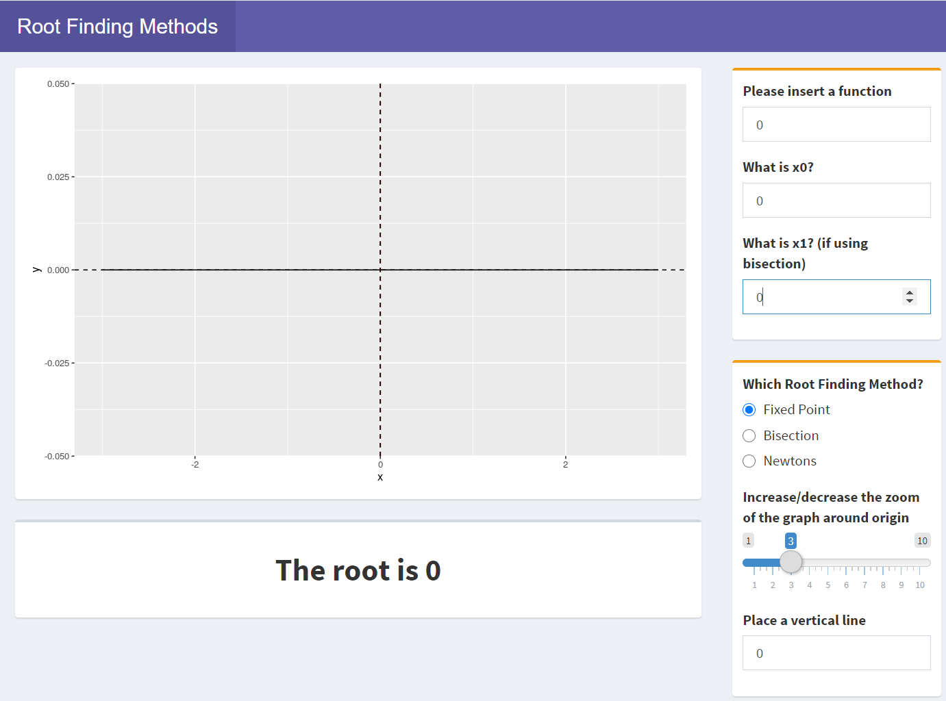
Methods Used:
Fixed Point
Bisection
Newton-Raphson

Slide 5
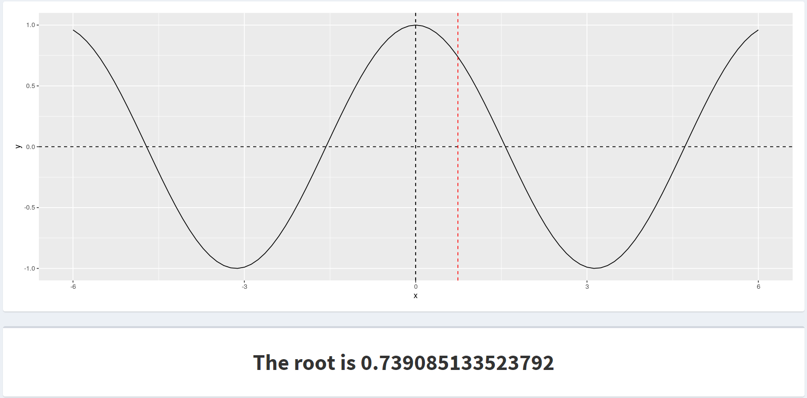
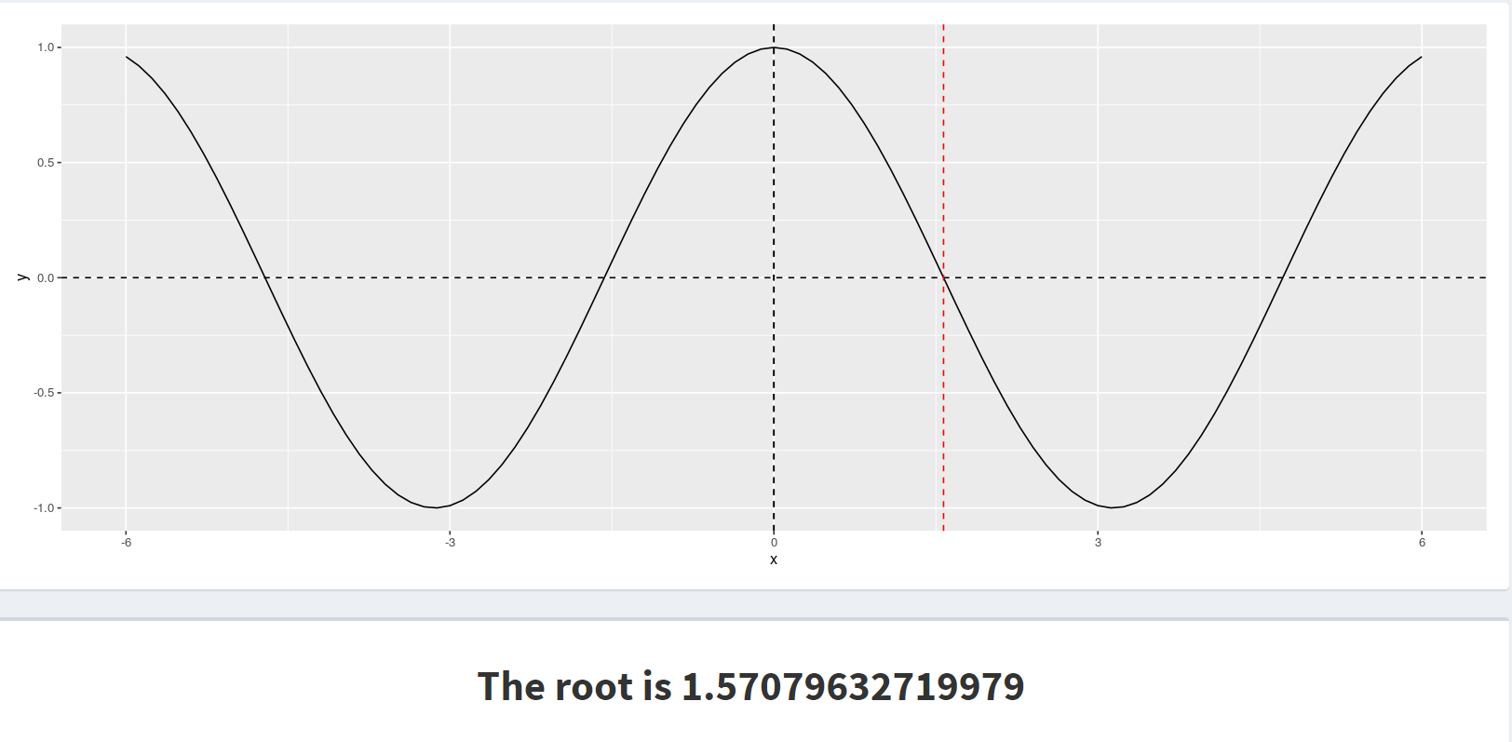
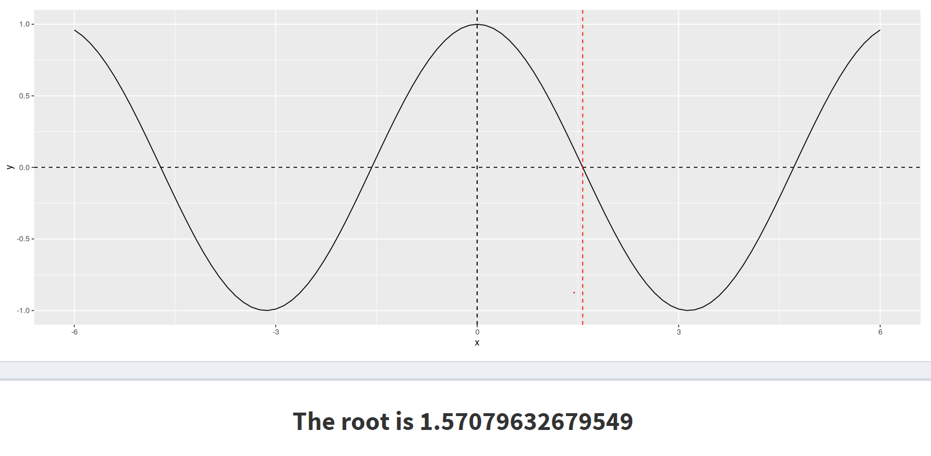
Root Finding Methods - f(x) = cos(x)
Fixed Point
Bisection
Newton - Raphson

Slide 6
Demo

Slide 7

Thank You!
Link to our GitHub

